Slide 1
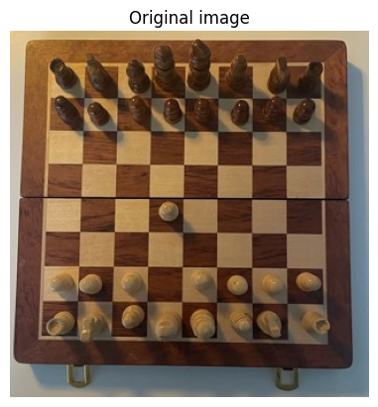
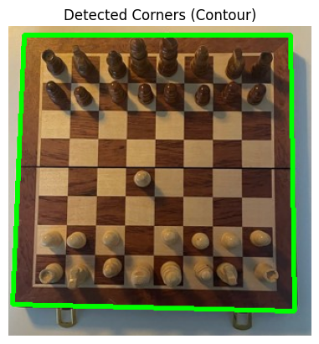
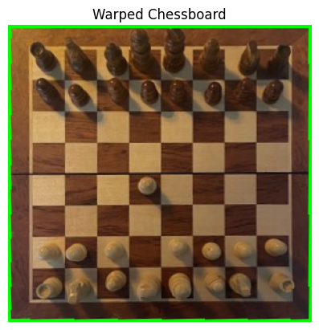

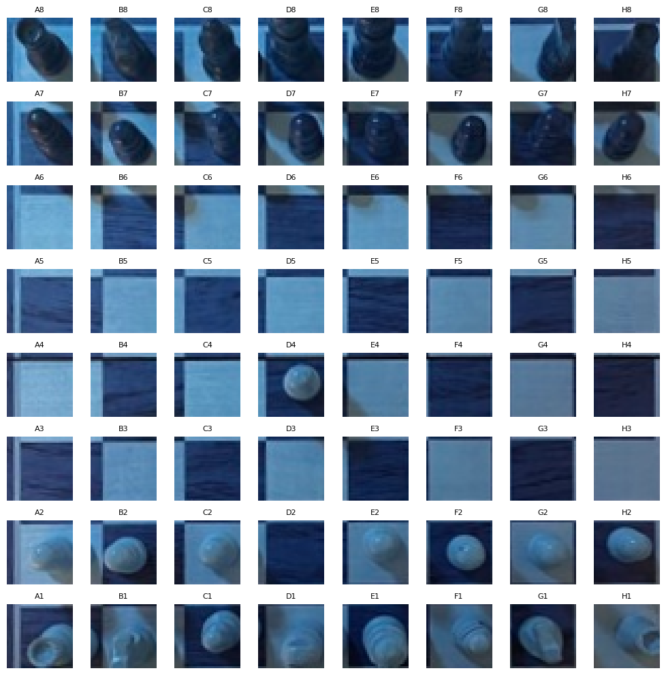
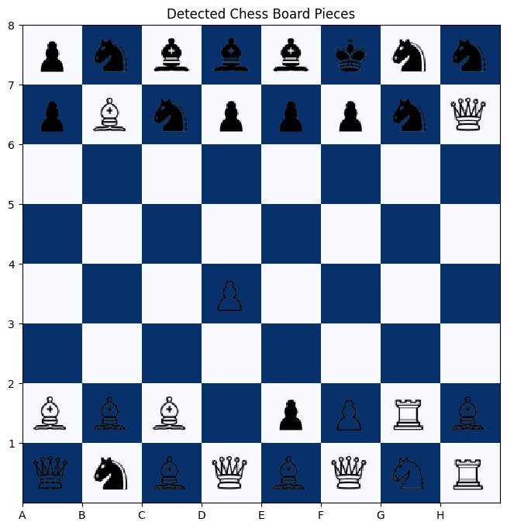
Chessboard Detection Pipeline
To optimize accuracy and generalization to various angles, we decided to build an MVP leveraging corner detection, perspective wrapping, deep learning and visualization¹.
1
2
3
Detecting corners (Canny)
Perspective transformation
4
Divide board in square positions
5
Custom board visualisation
Note:
⁽¹⁾ Source: Github of another real life chess vision project

Slide 2
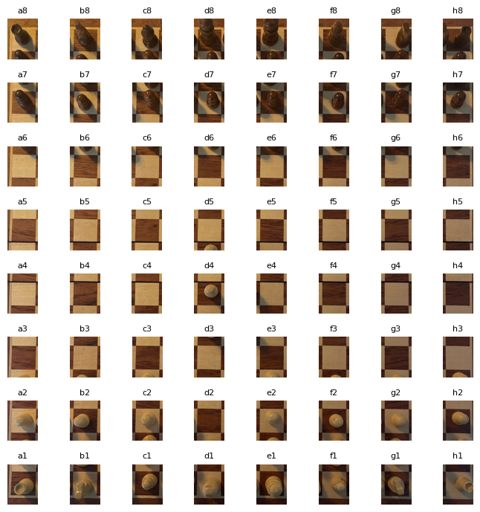

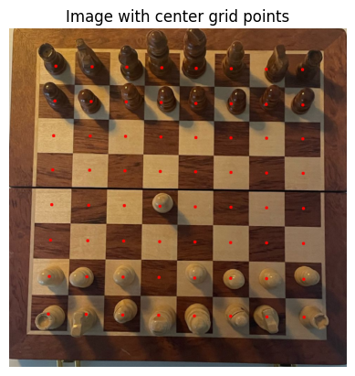
Chessboard Annotation Pipeline
Pipeline created to quicken the chessboard annotation process and have the right format for each cell (as opposed to screenshot).
Extracted Cells & Pieces
Manual classification
Note:
⁽¹⁾ Source: Github of another real life chess vision project

